Slide 1
How to make buttons on Photoshop for super dummies
by:Group 5

Slide 2
Step1 get photo shop

Slide 3
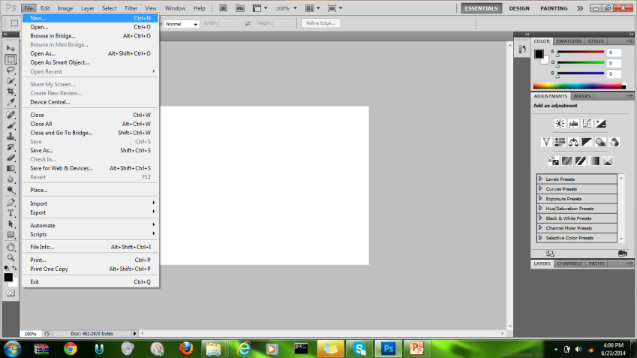
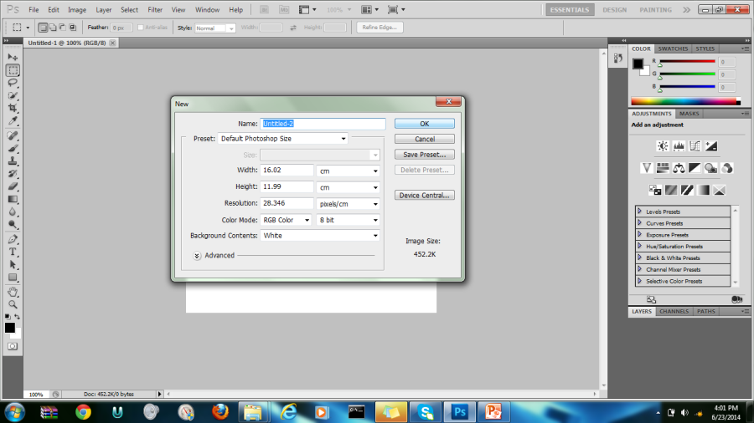
Step 2 open up and start new doc
File>new>click
Click ok after you chose the screen resolution and size you prefer.

Slide 4
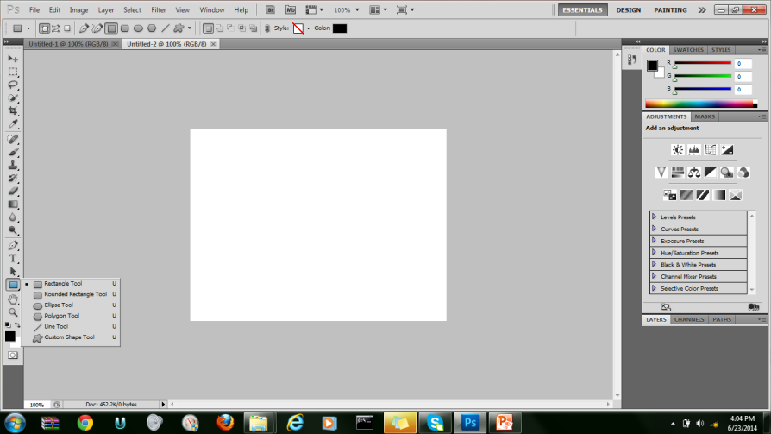
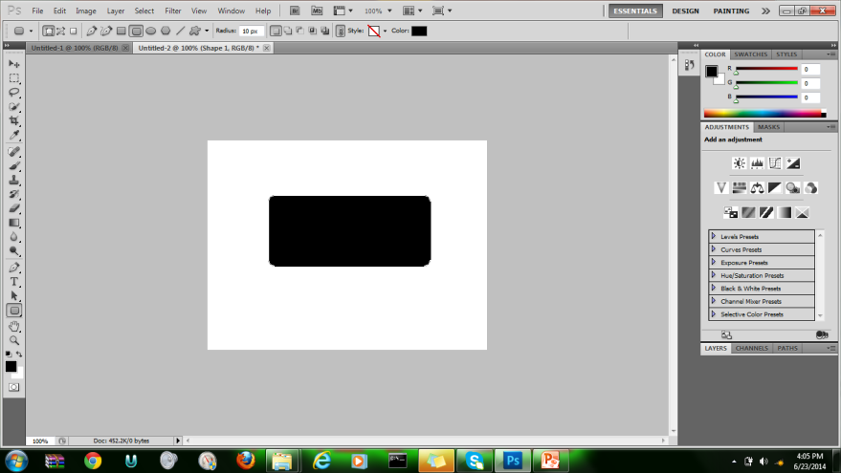
Step 3 making the basic button layer
Right click and chose the shape of the button you would like to make. I will be using the rounded rectangle.
Click and drag on screen to make the shape it will then be filled with a color

Slide 5
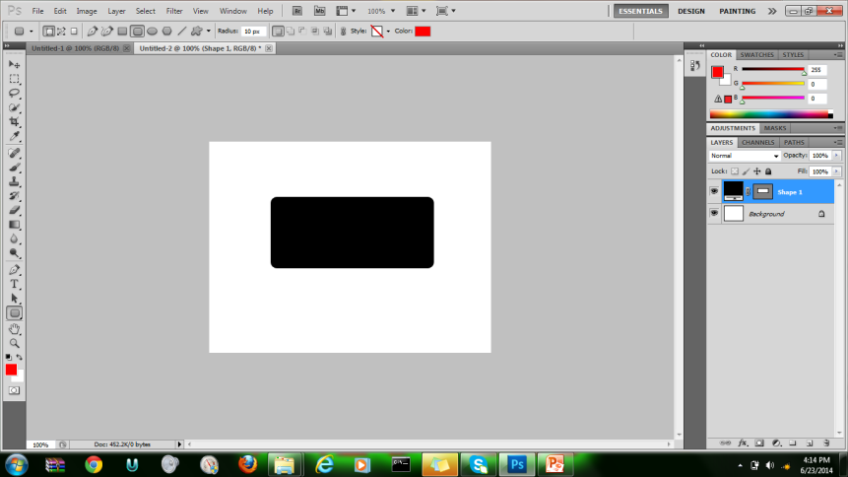
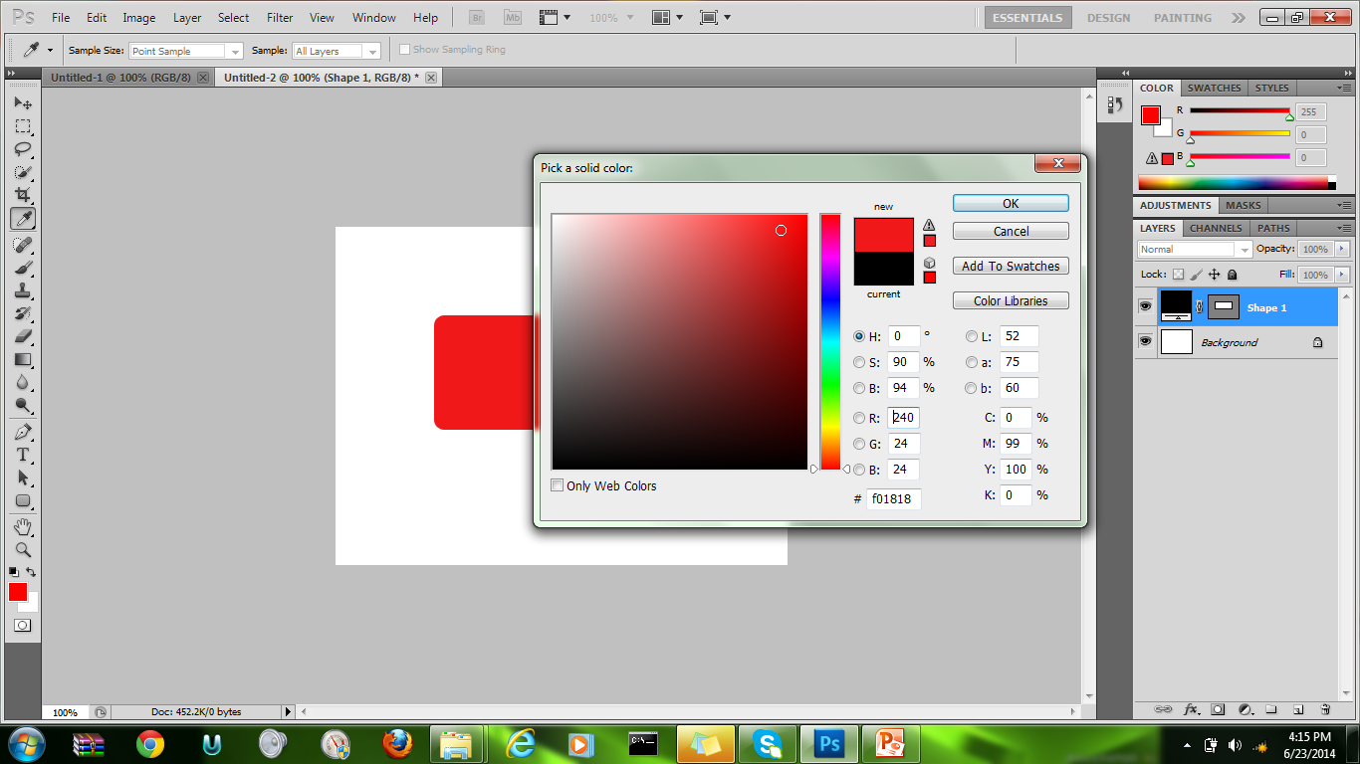
Step 4 Color specification
Double click on the color box on the layer of the button then select a color of your liking. Then click ok your shape will change to that color.

Slide 6
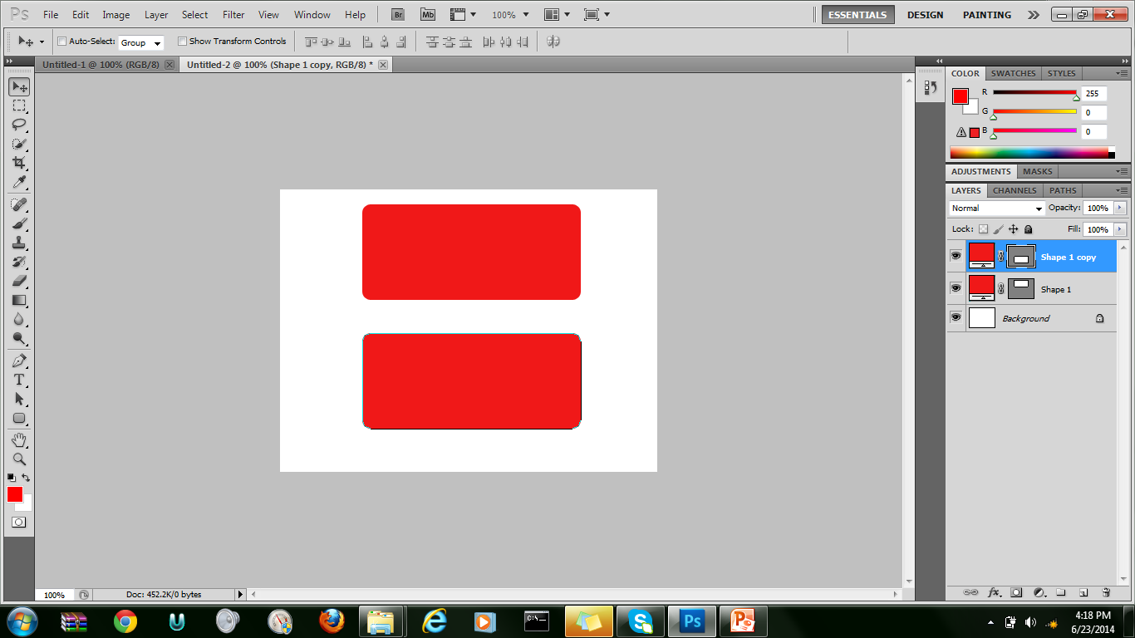
Step 5 adding a text layer
First you must creat a second button the same as the first this can be done by right clicking on the layer on the right side of photoshop folowed by clicking on the duplicate layer button when you are done with this your screen should look something like this.

Slide 7
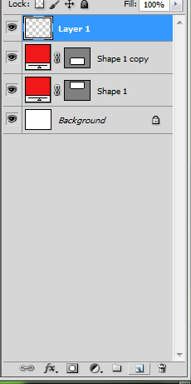
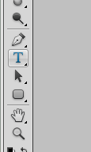
Step 6 adding the text layer cont.
First 2 aditional layers must be added for text
Then add thext on to them by going to the text tool and clicking it then clicking and draging over the button layers typing the same text such as NEXT

Slide 8
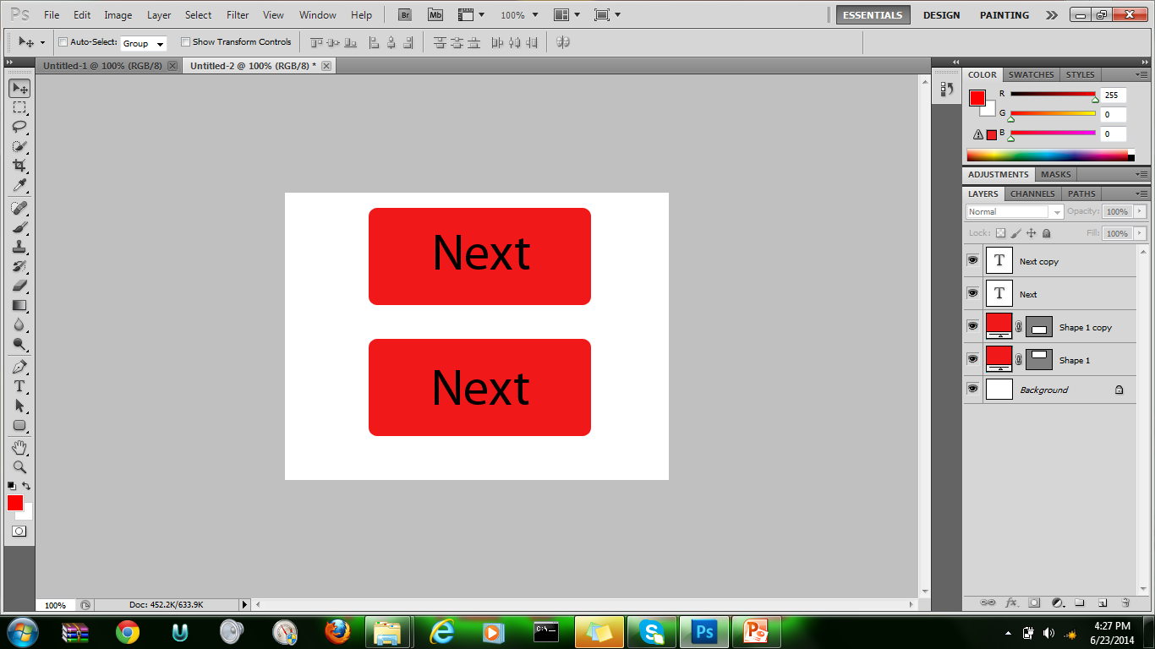
Step 7 adding the text layer cont.
Your work should look like this before we can move to the next step make sure the layers are in this ourder .

Slide 9
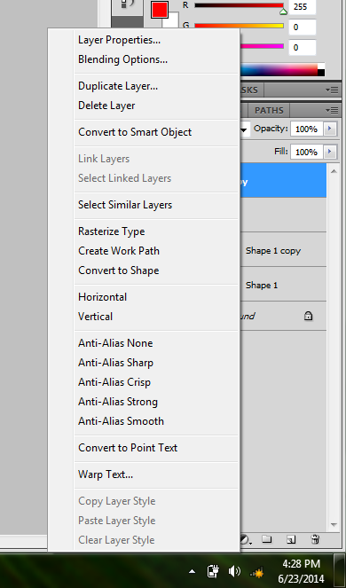
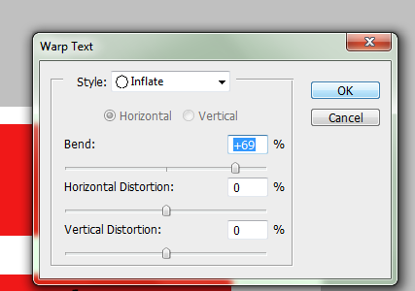
Step 8 Text warp & shade on button 2
Right click text layer for button 2 and click warp text then when prompted with
A new window do the following.

Slide 10
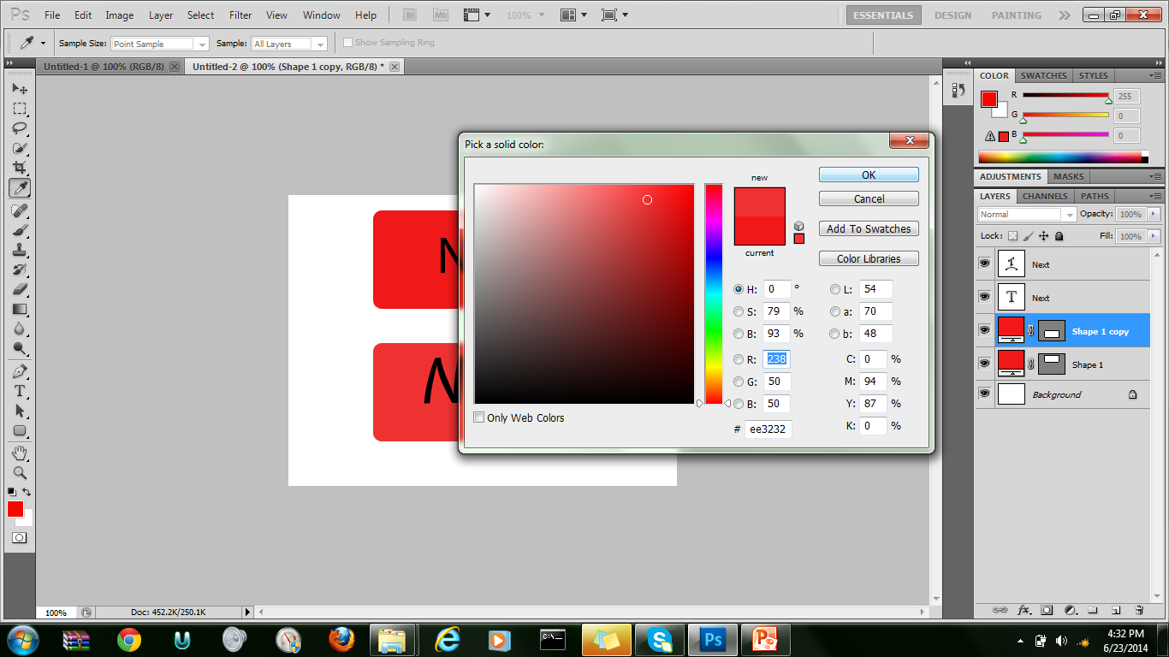
Continued
Add shade by following the same steps to change color and just making it lighter or darker

Slide 11
done

